Slide 1
Boox - Sprint 1
Charlotte Owen - Project Manager
Abele Amsalu - Scrum Master
Jonny Martinez - Programmer 1
Camille Pascua - Programmer 2
Raheel Jooma - Quality Assurance

Slide 2
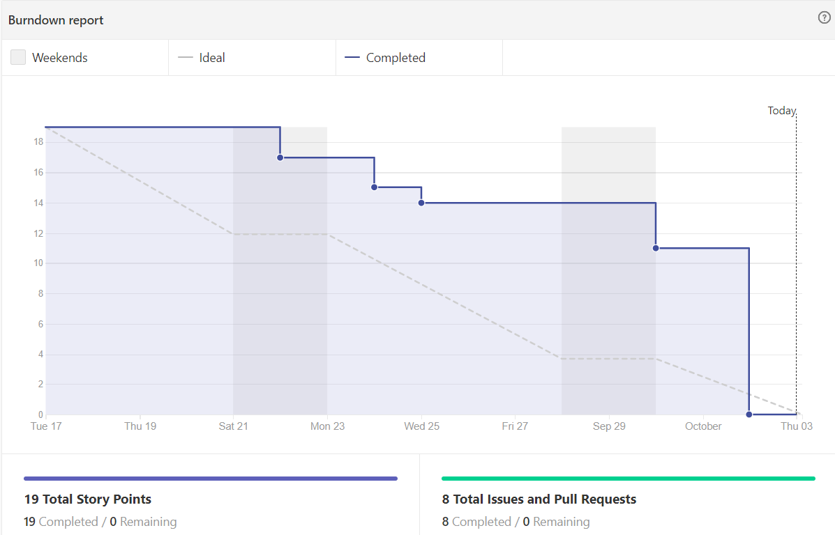
Metric: Time
Burn Down Chart

Slide 3
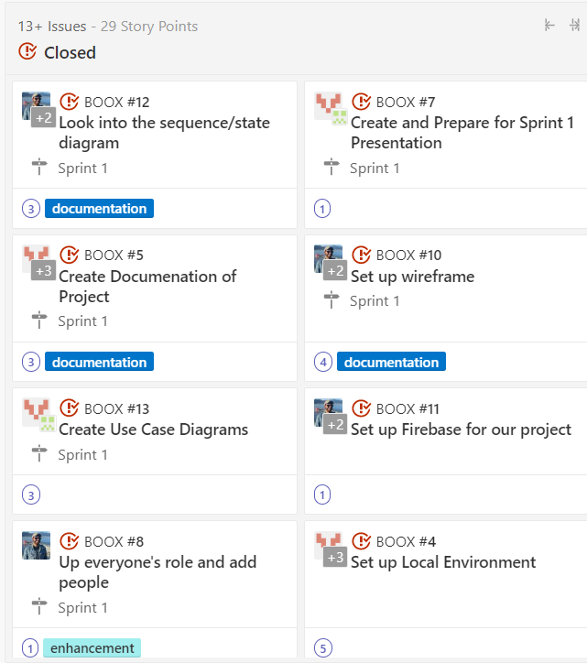
100%
We completed all our stories, Wahoo!

Slide 4
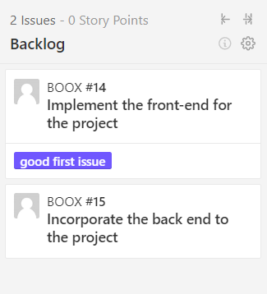
Backlog
Risks:
We might have some issues incorporating the Pixabay login component onto our project.
Time constraints in the sense that our whole team will be having midterms in the upcoming weeks.

Slide 5
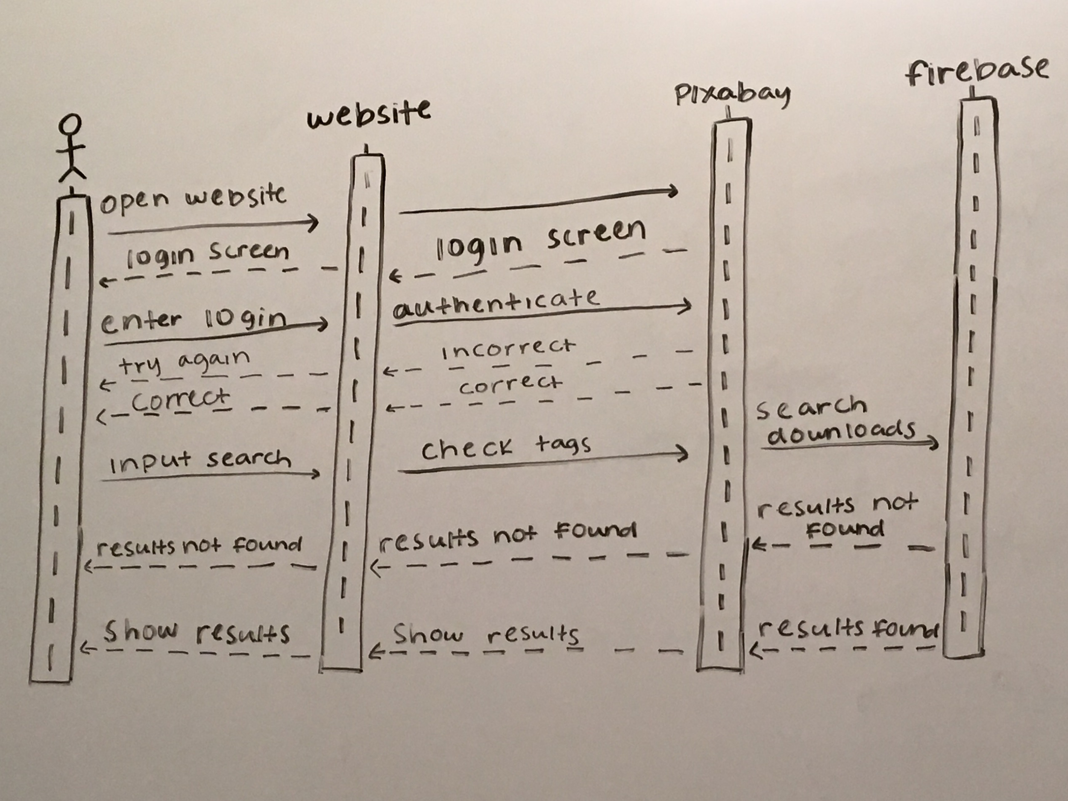
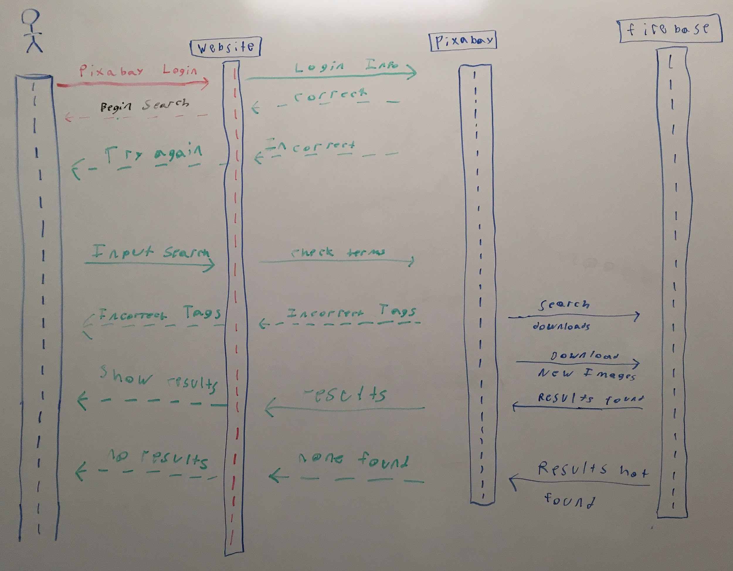
Sequence Diagrams

Slide 6
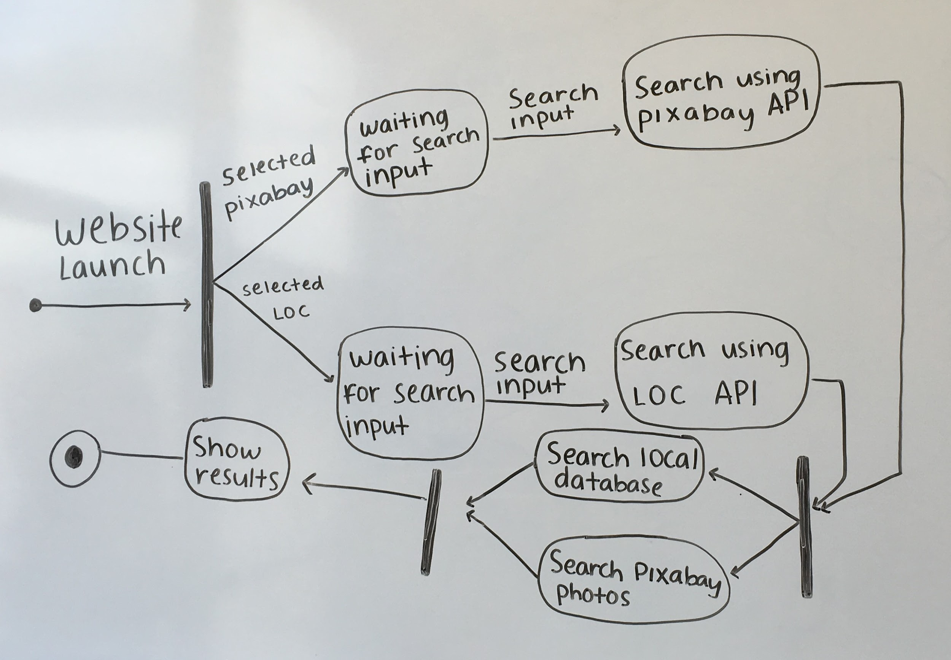
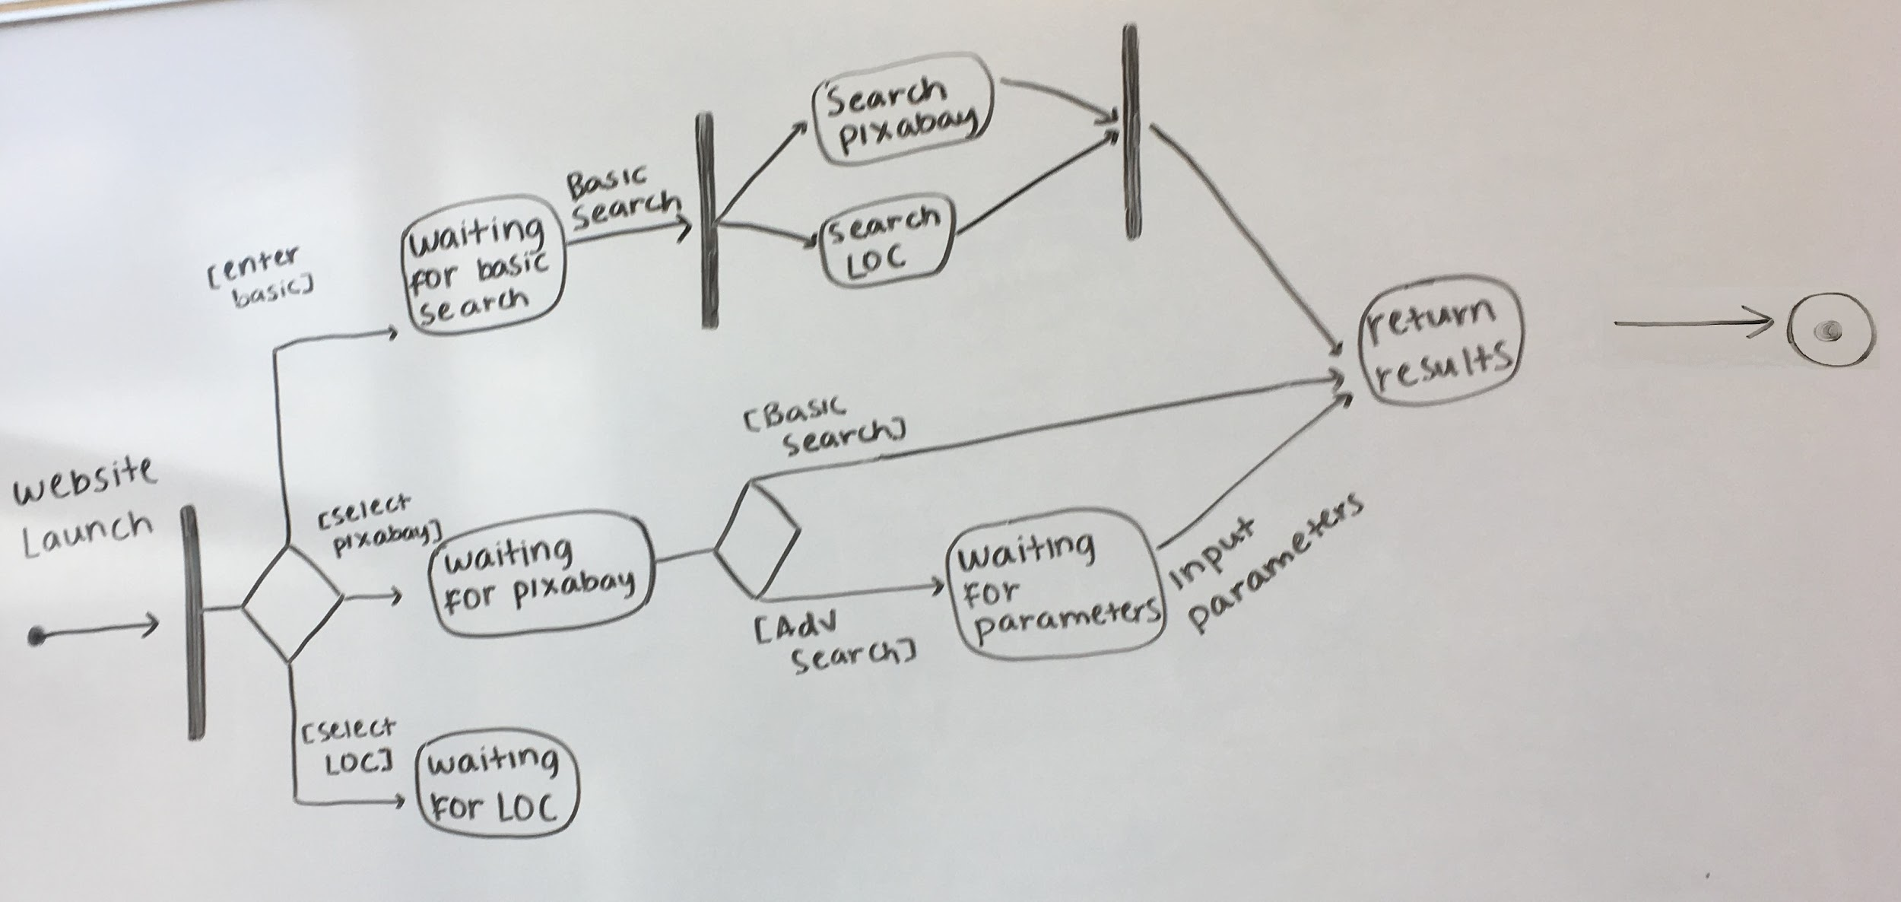
State Diagrams
Advanced search
Basic search

Slide 7
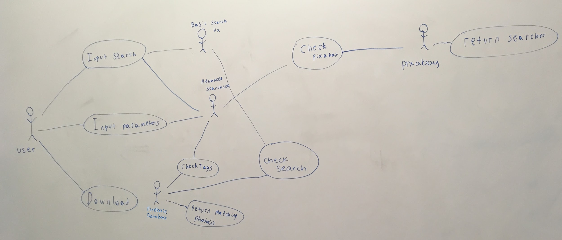
Use Cases Diagram

Slide 8
Thank you

